Slide 1

SOFTWARE DEVELOPMENT PRACTICES
UNIT - 1
MINI PROJECT
BY
NAME: GADANA SRI LAKSHMI
REG.NO: 111725110016
BRANCH: EEV

Slide 2

SOFTWARE REQUIREMENTS SPECIFICATION (SRS)
ONLINE complaint
registration and management system road problem

Slide 3

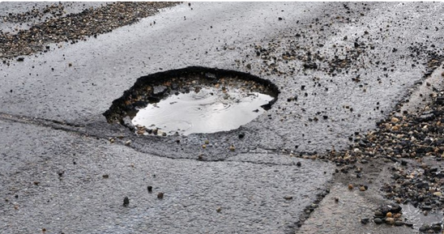
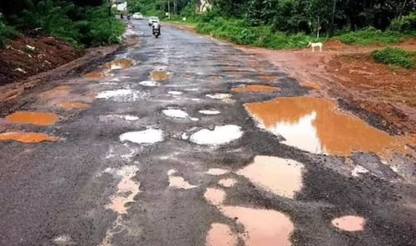
PURPOSE
The purpose of this document is to define the Software Requirements Specification (SRS) for the Online Complaint Registration and Management System (OCRMS) focused on road-related issues. This system will enable citizens to report road problems such as potholes, damaged signs of the road, blocked drainage, or streetlight failures to the concerned municipal or road maintenance authorities. It will also allow authorities to manage, track, and resolve complaints efficiently.

Slide 4
PRODUCT SCOPE
The OCRMS will be a web-based and optionally mobile-compatible application that provides the following functionalities:
Citizens: Register, log in, submit road complaints with descriptions, locations,
images. Track complaint status and receive notifications.
Authorities/Admin: View, prioritize, assign, and resolve complaints. Update complaint status and communicate with users.
System: Auto-generate complaint IDs, notify users about status changes, maintain complaint history, and generate reports.
The main goals are:
To provide a simple and transparent platform for citizens to report road issues. To streamline complaint handling and reduce resolution time.

Slide 5

Definitions, Acronyms, and Abbreviations
OCRMS: Online Complaint Registration and Management System
Admin: Municipal authority or road maintenance department official
User/Citizen: A registered individual who reports a complaint
Reference Government guidelines for municipal grievance redressal systems

Slide 6
FUNCTIONAL REQUIREMENTS
Hardware Requirements
Standard desktop or smartphone with internet connection.
Software Requirements
Database: MySQL/PostgreSQL
API: Google Maps API for geolocation
Email/SMS services for notifications

Slide 7
NON FUNCTIONAL REQUIREMENTS
PORTABILITY :
The system shall be platform-independent and run on all major operating systems (Windows, Linux, macOS).
The web application shall support all major browsers (Chrome, Firefox, Edge, Safari).
The system should be easily deployable on cloud platforms (e.g., AWS, Azure, GCP) as well as on-premises servers.
Mobile version (optional) should run on Android and iOS without significant changes to core functionality
SECURITY :
All passwords stored with encryption.
Use HTTPS for all transactions.
Role-based access control for admin and users.

Slide 8
MAINTAINABILITY :
Modular architecture for easy updates.
Well-documented codebase.
RELIABILTY :
The system should have 99.5% uptime annually.
It shall recover from any system failure within 5 minutes.
The system should support automatic backups at least once every 24 hours.
SCALABILITY :
The system should support horizontal scaling (adding more servers) to handle an increasing number of users and complaints.
The database should be able to grow to store millions of complaints without significant performance impact.
The application architecture should support future integration with other municipal systems or IoT sensors.

Slide 9
PERFORMANCE :
Response Time:
The system shall respond to user requests (e.g., complaint submission, status retrieval) within 3 seconds under normal load.
Throughput:
The system should be able to handle at least 1000 concurrent users without performance degradation.
Complaint Processing:
Complaints should be logged, assigned, and status updated in real-time.
Latency:
Notifications (email/SMS) should be delivered within 30 seconds of a status change.

Slide 10
SYSTEM FEATURES

Slide 11
1. User Registration & Authentication
Users can create accounts and log in securely.
Forgot password and password reset functionality.
Admins can manage (add/delete) user accounts.
2. Complaint Submission
Users can submit complaints about road issues such as potholes, streetlight problems, drainage issues, etc.
Users can attach images, add a description, and specify the location (manual or via map).
The system generates a unique complaint ID automatically.
3. Complaint Tracking
Users can view the status of their complaints: Submitted → Under Review → In Progress → Resolved.
Users receive notifications (email/SMS) about status changes.
Users can see complaint history.

Slide 12
4. Complaint Management (Admin)
Admins can view all submitted complaints.
Admins can assign complaints to field staff or departments.
Admins can update the complaint status and add comments.
Admins can close resolved complaints.
5. Reporting and Analytics
The system can generate reports by:
Complaint type
Date range
Area/region
Status (Open, In Progress, Resolved)
Admins can export reports to CSV/PDF.
6. Notification & Communication
Users are notified when the complaint status changes.
Admins and users can exchange messages for additional information.
Optional: Users receive feedback requests after complaint resolution.

Slide 13
USE CASE DIAGRAM
Actors
Citizen/User: Registers, logs in, submits, and tracks complaints.
Admin: Manages complaints, updates status, generates reports.
ENGINEER: VIEW COMPLAINTS,UPDATE PROGRESS,CLOSE COMPLAINT.

Slide 14
CITIZEN
ADMIN
ROAD MAINTENANACE ENGINEER
Register/
Login
Views complaints
VIEWS ASSIGNED COMPLAINTS
USE CASE DIAGRAM
submit complaint-Enter details
Assign complaint to Department
UPDATE PROGRESS
System generates ID & stores complaint
Complaint status will be updated
CLOSES COMPLAINT
Notification sent (complaint submitted)
Citizen tracks status & views history
GENERATE REPORTS (ADMIN)

Slide 15

THANK YOU

